Slide 1
Basketball Ontology
Overview of Classes | Three Point Shot

Slide 2
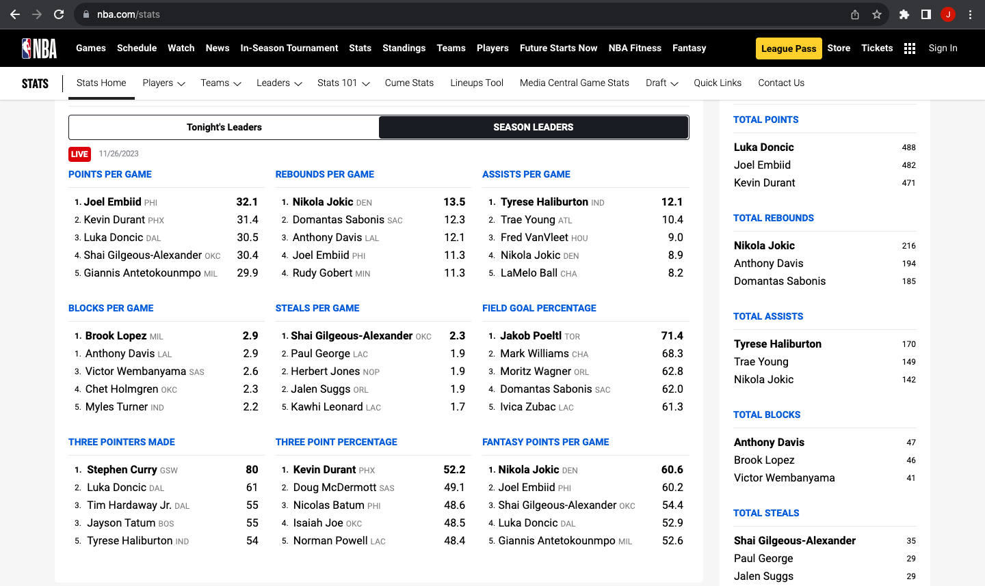

Slide 3
CCO: Planned Act
Intentional Match Act
Referee Act
Scorekeeper Act
Player Act
Score Change Act
Selected Player Act
Bench Player Act
Judgment Act
In Possession Act
Out of Possession Act
Off Ball Act
On Ball Act
Block Act
Shot Act
Free Throw Shot Act
Three Point Shot Act
Notes:
Actions Taxonomy

Slide 5
BFO: Role
CCO: Agent
CCO: Occupation Role
subclass_of
Basketball Player Role
subclass_of
RDF:type
NBA Team Player Role
subclass_of
Point Guard Role
Player 1
(Steph Curry)
RDF:type
RDF:type
has_role
has_role
Basketball Player Role 1
member_of
participates_in
Team Player Role 1
(Warriors)
Match Group 1
Match 1
RDF:type
RDF:type
CCO: Group of Agents
BFO: Process
Notes:
Player Roles/Teams

Slide 6
BFO: site
CCO: Facility
BFO: fiat boundary
subclass_of
subclass_of
Hoop
subclass_of
subclass_of
Basketball Stadium
located_in
Basketball Court
located_in
Court Line
located_in
subclass_of
subclass_of
subclass_of
Free throw line
Three point line
Boundary line
has_continuant_part
has_continuant_part
Two point zone
designated_by
subclass_of
subclass_of
Three point zone
baseline/endline
sideline
Notes:
Court

Slide 7
Three point zone
CCO: Agent
Judgment Act
RDF:type
RDF:type
RDF:type
RDF:type
Player 1
(Steph Curry)
Three Point Zone 1
Referee 1
located_in
Judgment Act 1
agent_in
agent_in
Shot 1
Three Point Shot Act
RDF:type
process_part _of
Score Tally 1
Basketball 1
is_cause_of
Score Change 1
participant_in
is_measured_by
RDF:type
Basketball
RDF:type
agent_in
RDF:type
Scorekeeper 1
CCO: Count M.I.C.E.
subclass_of
CCO: Material Artifact
Notes:
Successful 3 Point Shot

